Slide 1
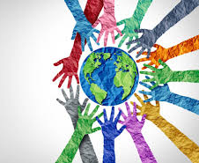
What is Culture?

Slide 2
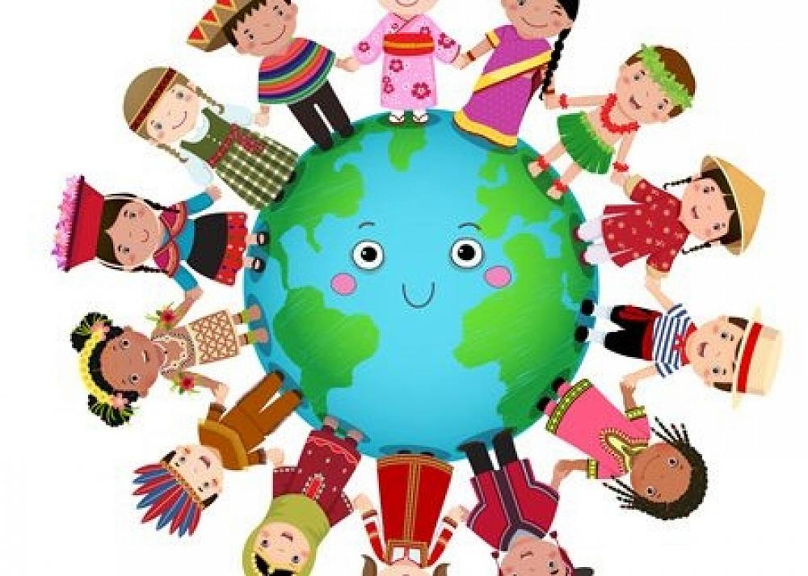
What is Culture?
Culture is learnt from our upbringing.
It includes traditions, religious beliefs, our values, food & clothes.
These influence our behaviour.
We may pass these influences onto the people around us.

Slide 3
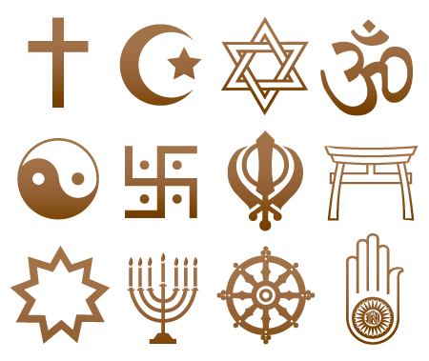
Britain
A place of different religious faiths

Slide 4
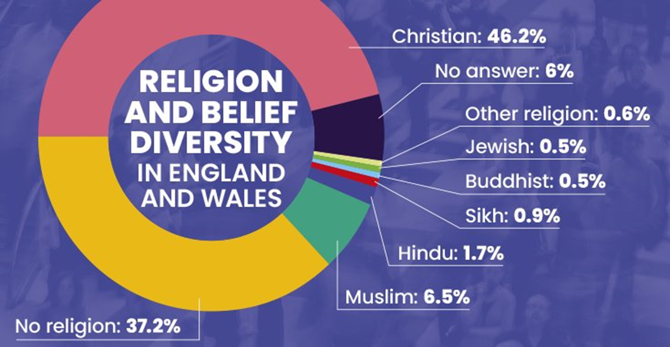
Proportion of faiths

Slide 5
Cultural Respect
Britain is a population with many religious beliefs.
Each person has been brought up in a culture that their family believes in.
Despite some differences, it is important that we respect each others beliefs. Religions have a huge amount of sacred history!

Slide 6
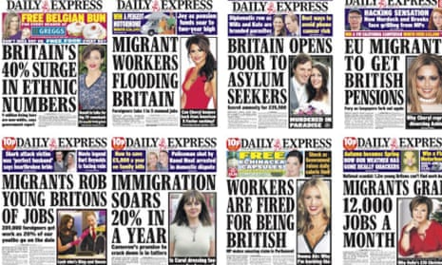
Do you think these headlines are respectful?

Slide 7
Recent events…

Slide 8
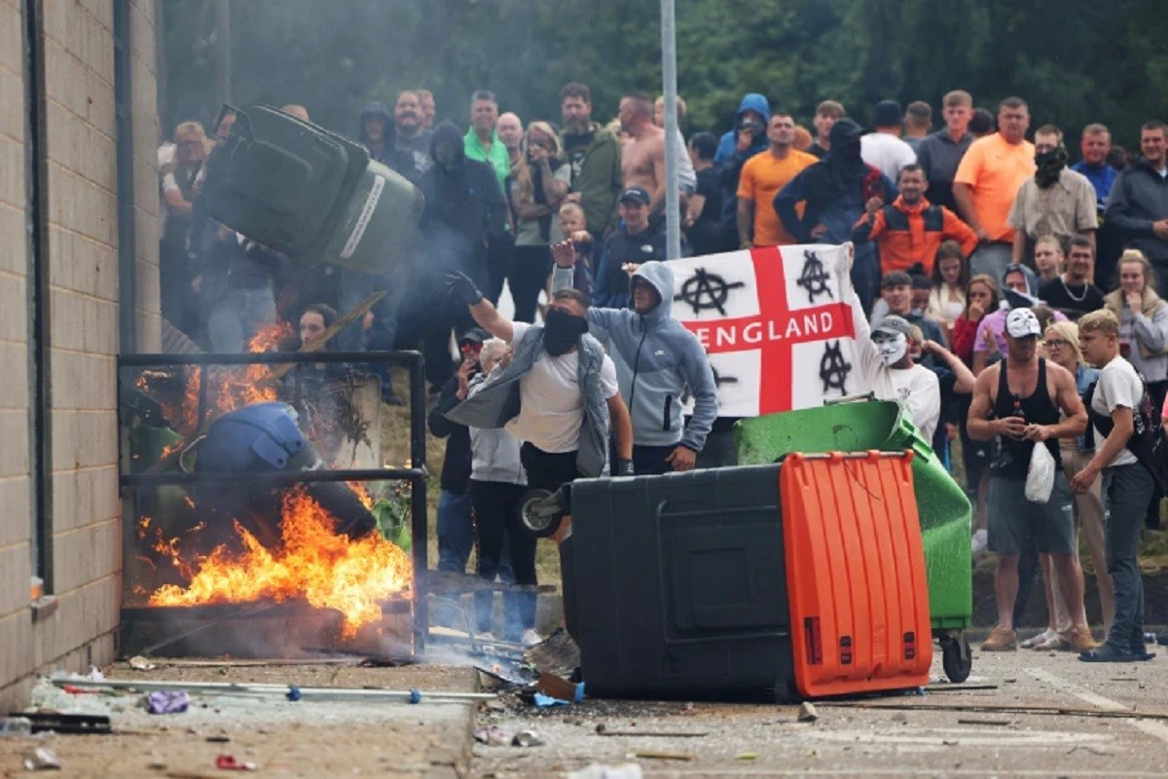
UK Riots Fueled by Anti-Immigrant Hate Crimes

Slide 9
UK Riots Fueled by Anti-Immigrant Hate Crimes
In recent weeks, the UK has witnessed an alarming escalation of violence and unrest, with riots spreading across cities and towns. At the heart of this turmoil is a troubling rise in anti-immigrant hate crimes.

Slide 10
The Surge in Violence
The riots that have erupted across the UK are not isolated incidents but rather a manifestation of deep-seated tensions. Reports indicate that many of these disturbances have been ignited by hate crimes targeting immigrant communities. From vandalism and physical assaults to verbal abuse and discrimination, the intensity of these attacks has contributed significantly to the current climate of unrest.

Slide 11
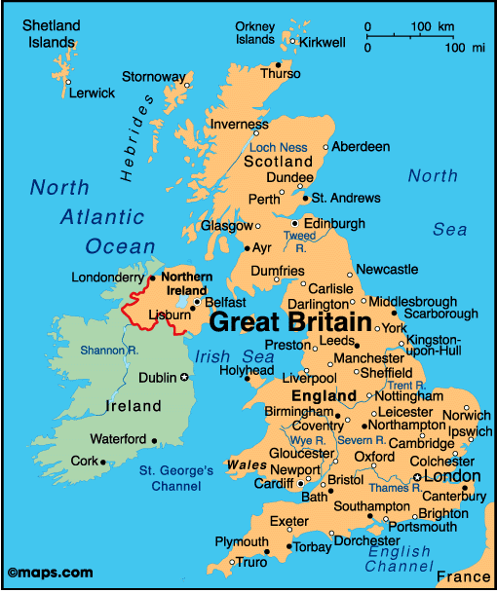
Lets go from the start…

Slide 12
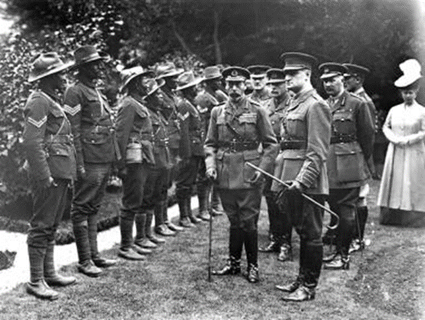
Diversity of the UK
Britain, down to its deepest roots, has always been a diverse nation.
Our diversity is a result of invasion, expansion, empire and Commonwealth, and being a safe haven for people fleeing danger.
For over 2000 years people have arrived in Britain, contributing their own cultural influence.

Slide 13
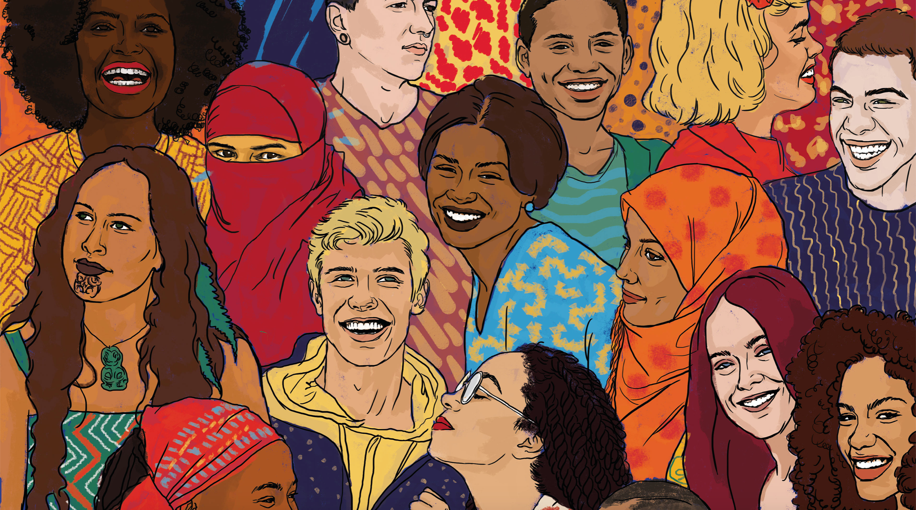
Diversity of the UK
Much of our diversity comes from the British Empire, which at its height governed over one quarter of the world’s population – that’s 458 million people!
After the British Empire collapsed, people from the Commonwealth migrated to Britain, and migrants were invited to help strengthen our workforce.

Slide 14
Diversity of the UK
Today, people continue to move all around the world.
Our current population of over 60 million people includes a mix of people from different racial, religious and cultural backgrounds.

Slide 15
Diversity of the UK
So what mix of culture does this mix of people bring to our country?

Slide 16







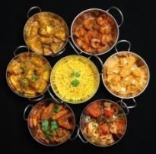

A mix of food

Slide 17
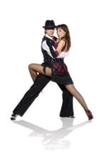
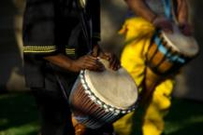


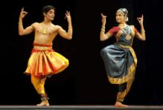




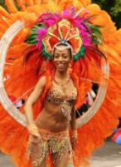
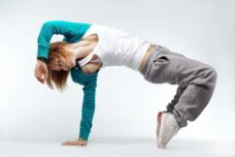


A mix of music and dance

Slide 18

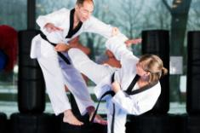
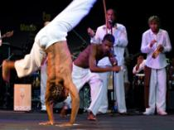


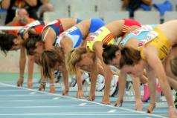
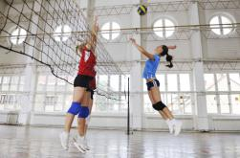
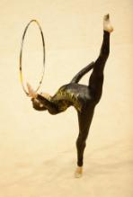


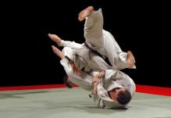
A mix of sports

Slide 19
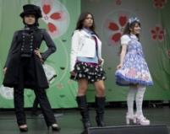
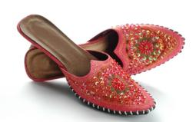


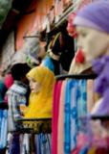
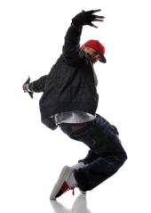



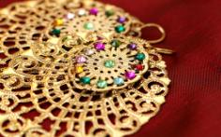
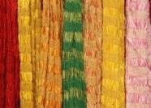

A mix of fashion

Slide 20



Our cultural life
Ethnic diversity has made our society rich in culture and contributed to our economic, social and democratic development.
Everything in modern Britain – from music and fashion to food and language – has been influenced by different ethnic communities, cultures and social groups...

Slide 21
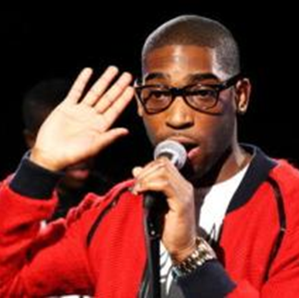
Our cultural life
British music combines influences from all over the world. Some of our most successful musicians are from ethnic minority groups.

Slide 22
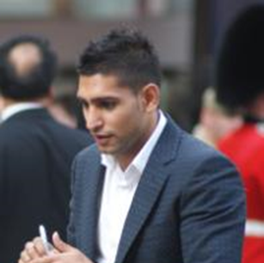
Our cultural life
Sportsmen and women from ethnic minority groups have made huge contributions to our sporting success and achieved world class status.

Slide 23
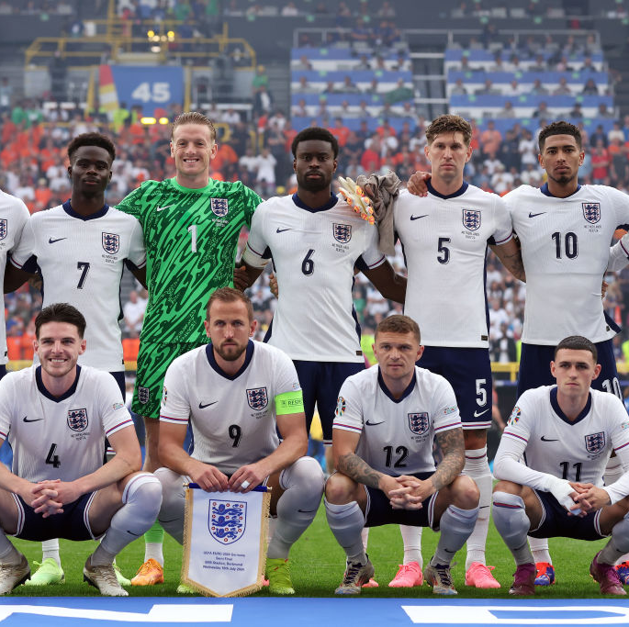
Without immigration, some England players wouldn’t live here.

Slide 24

Lets change things
When we talk about diversity, we don’t just talk about race and ethnicity.
Diversity includes all different people, each contributing their own uniqueness, making Britain a more interesting place to live.
So diversity includes people of different gender, ages, sexual orientation, disability, religion, beliefs and more.
It is important that everyone respects and celebrates each other’s differences so we can all get along, learn from each other and share an exciting mix of cultures and experiences.

Slide 25

Respect our differences
It is important to celebrate and respect that we are all different.
Remember, we are all different in our own way (each one of you), and we all add something special to the diversity of our country.
The world would be a boring place if we were all the same!
Finding out about different cultures and discovering the different ways that people live and think is fascinating, and helps everyone to get along and understand each other better.
So let’s show some respect for difference.

