Slide 1
Bookopoly is back!!!
Bradon Forest Library
Yr9 + KS4 Reading Competition 2025/26
Tuesday 16th September – Thursday 8th January

Slide 2
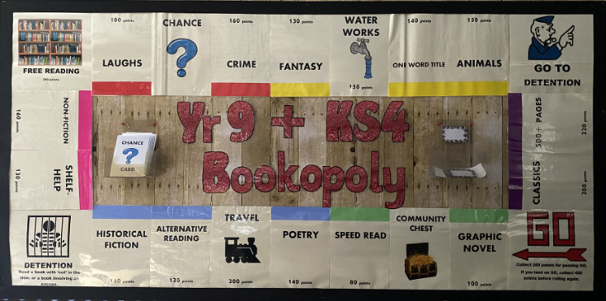
NEW AND UPDATED BOARD FOR 2025!

Slide 3
Introducing: Bookopoly
Bookopoly is a giant board game where players read to score points.
The space they land on will dictate the style, topic or genre of their read for that turn.
One turn can take as little or as much time needed to complete the read. More points are awarded for longer and more challenging reads.
Players are encouraged to choose books that suit their reading abilities – audio books, speed reads, story collections and dyslexia friendly books are encouraged throughout.
Players will complete a short book review to finish each turn before their next roll.
The competition will run for just under 4 months, players can take as many turns as they wish to in that time (they do not need to wait for others to take their next turn).

Slide 4

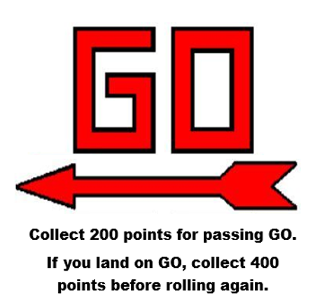
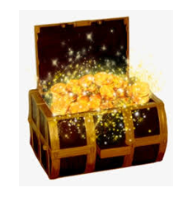

Special Spaces
Some spaces work a little differently:
GO gives you extra points
Free Reading is a book of the reader’s choice
Landing on Chance gives an activity card – this can earn extra points or give some to another player
Community chest spaces is an instant spot prize

Slide 5

Bonus points and prizes
Choosing a member of staff before they sign up, players have the chance to earn 200 bonus points, if they beat their staff partner’s score by the closing date.
Bonus points can also be found (and lost) on some Chance cards.
Bonus points may be awarded at Mrs Sirrelle’s discretion, for particularly high standard book reviews.
Any player landing on a Community Chest space will win an instant spot prize.

Slide 6
How to join the competition
Visit the library before school, during break or at lunch to sign up – first rolls will begin at breaktime on Tuesday 16th
Roll the dice and move the corresponding number of spaces
Complete the read or activity for the space you have landed on
Review your read to log your points with Mrs Sirrelle
Collect as many points as you can before the end of the competition to be in with a chance of winning.

Slide 7
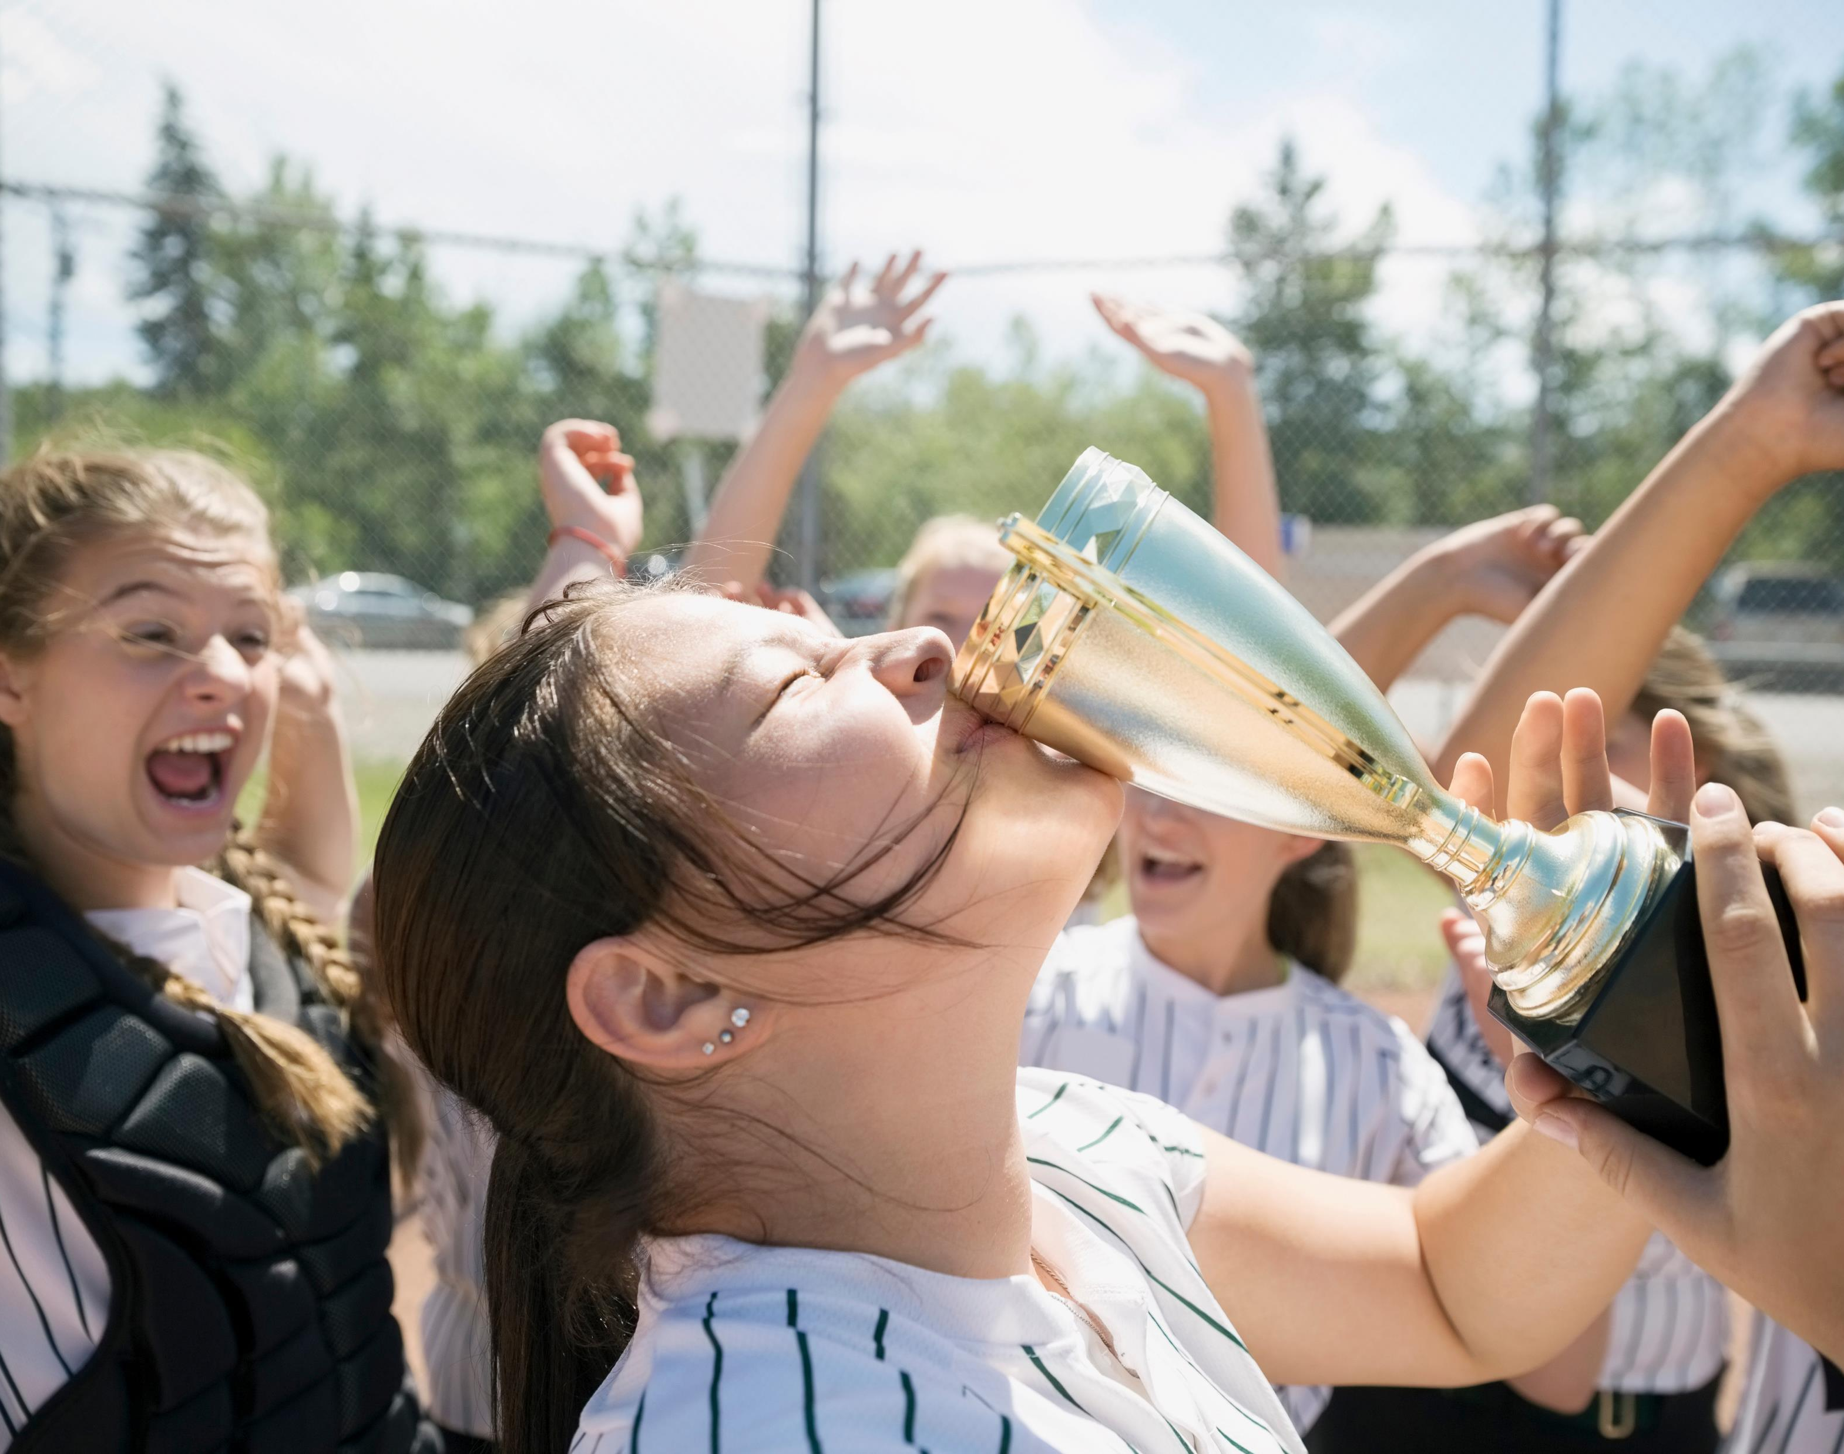
Prizes
1st place prize will be a £15 voucher and 5 house points.
2nd place prize will be a £10 voucher and 3 house points.
3rd place prize will be a £5 voucher 2 house points .
All participants will be awarded 1 house point for taking part.
In the event of a tie – staff will judge players on the quality of their submitted book reviews.

Slide 8
Rules
Players can join the game at any time within the competition period (16.09.25 to 8.01.26)
No points will be awarded for reads before the start date, nor will any late entries be counted after 14:10 on the final day.
Players participate in good faith – anyone found not following the rules will be automatically disqualified from winning any prizes.
If a player does not wish to finish a book, they may choose another under the same space, or roll again for a new space. They will not be awarded points for an incomplete read.
Books/resources do not need to be from the school library, they may be privately owned, or from a public library service for example.

