Slide 1
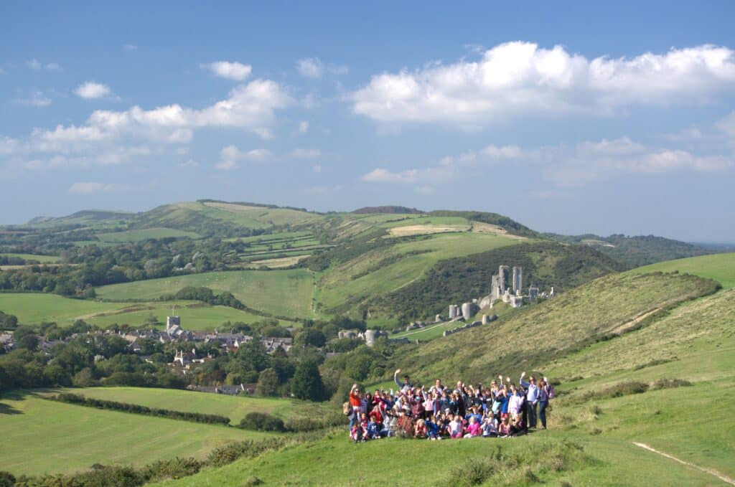
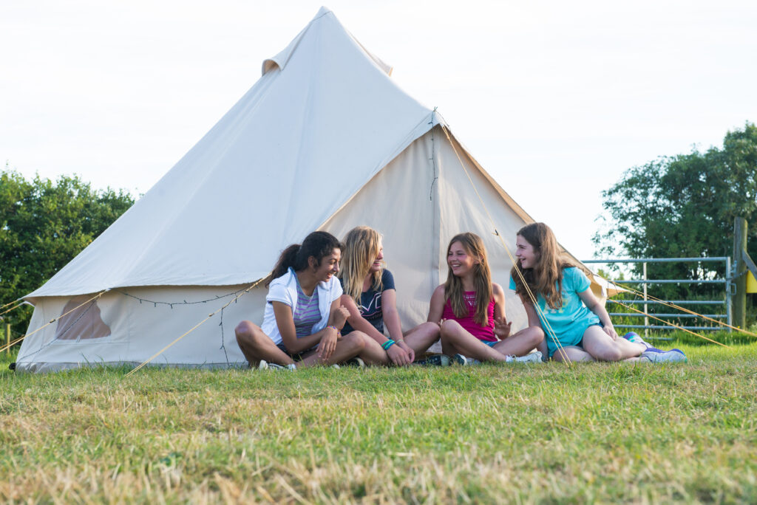
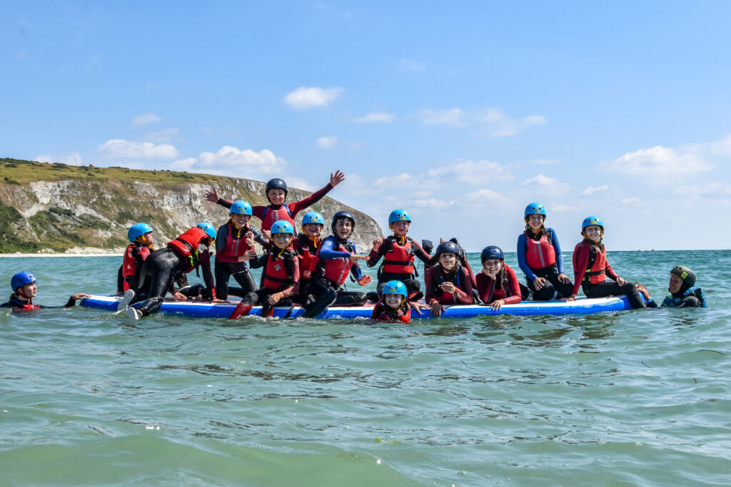
Parent/Student Information Evening
Land and Wave Trip 2026 – 13-14 July 2026.
WELCOME!
Please find the following documents on your seats:
Behaviour Contract – Blue
Medicines administration form – yellow
Kit List - White
Please return the documents to Miss Cole. If handing in tonight, please put them in the boxes at the front of the hall.

Slide 2
Countdown – 28 days to go!
Some trip admin…
Medical forms – extra conversations/meetings if needed – return to Miss Cole if you have not already done so.
Medicine Administration form – this is to be filled in for students who will need medication of any kind while on the trip. Please return this to Miss Cole by 25th June (just the form – this is so I can forward plan)
Information sessions for students – please check the bulletin – in the fortnight before the trip.
Parents can email Miss Cole with any questions. ccole@bradonforest.wilts.sch.uk
Final letter to parents - This will have all the details, including emergency contacts. Please keep it safe – we will schoolcomms this to parents.
Fitness – eat well, sleep well!
Behaviour Contract – sign and return to Miss Cole
Land and Wave email – there are a few more students who still need to complete the link on the portal. Miss Cole has emailed parents to remind. This must be completed asap. Please see the Land and Wave email for details.
Notes:
Arthur Lloyd
Becca Parker

Slide 3
Keeping in touch -
We will be posting on Instagram each day – to keep parents updated.
We will encourage students to talk to teachers – in loco parentis. Talk to us!
We’d like to nurture and encourage responsible independence and life skills.
This is a mobile phone free trip for students – please leave them at home.
There will be an emergency contact phone for parents to use – in an emergency.
Bradon Forest School (@bradonforestschool) • Instagram photos and videos

Slide 4
Staff
Miss Cole – leading – Head of Humanities/Geography and EVC.
Mrs Lanphier – Head of Year 7/Teacher of English
Miss Beet– Head of Religious Studies
Mrs Loxton – Head of History
Mr Matthews – Teacher of PE
Mrs Wilson – Head of Battlewell House/Teacher of PE
Mr Clarke – Deputy Headteacher
Mrs Lister – Head of Year 11/Teacher of MFL
Mr Payne – Teacher of PE
Mrs Hazell – Deputy SENDCO/Teacher of English
Mr Nawaz – Teaching Assistant

Slide 5
Departure
Monday 13 July
Students to arrive at school by 8.30am and come to the hall.
Please come dressed for the day – shorts/t shirt/leggings/joggers/trainers.
Check the weather forecast – sunscreen, hat.
Please have waterproof coat, water bottle, sunscreen and packed lunch in your backpack.
Please pack all other gear in a suitable bag to go in the hold under the coach.
Group Staff will do checks – medical equipment – inhalers, EpiPens, bags labelled, have you got everything? Hand your medicines to your group teacher – in an envelope WITH YOUR NAME ON. Miss Cole should by then have received the medicines administration form from parents, so we have instructions on doses/times etc in advance.
Coaches will depart at 9am

Slide 6
Arrive home
Tuesday 14 July
School car park at around 4pm.
Please arrive in good time to pick up your child.
If we are delayed the school will send a message via schoolcomms.

Slide 7
Groups and Tents
Students will be in groups of 12 – mixed gender.
Groups are for the activities we will be doing – Corfe Castle Visit and
Water sports in Swanage.
I have asked for information on friendships so I can arrange groups appropriately – if you have not told me who your friend is, please tell me asap!
Tents are in groups of 6. I aim to sort these on Wednesday this week – during tutor and at lunchtime. This will be in H7.

Slide 8
Emergency contacts
Miss Cole will have a school mobile parents can contact – the phone number will be in the final letter. If any changes this will be communicated via schoolcomms.
EMERGENCIES ONLY
Staff will have access to parent phone numbers -
We will ask for these via a forms link on schoolcomms in the next few days. This will be in the final letter.
We appreciate we have parent phone numbers on our system, but sometimes numbers have not been updated – and this will save us some time.
There will also be an emergency contact back at school – this will be Mrs Haines – EMERGENCIES only. (final letter)
There will always be a meet point/time to come back to – for example when we are in camp.
Student should not go anywhere on their own.
Please buddy up and look after each other – safety first.

Slide 9
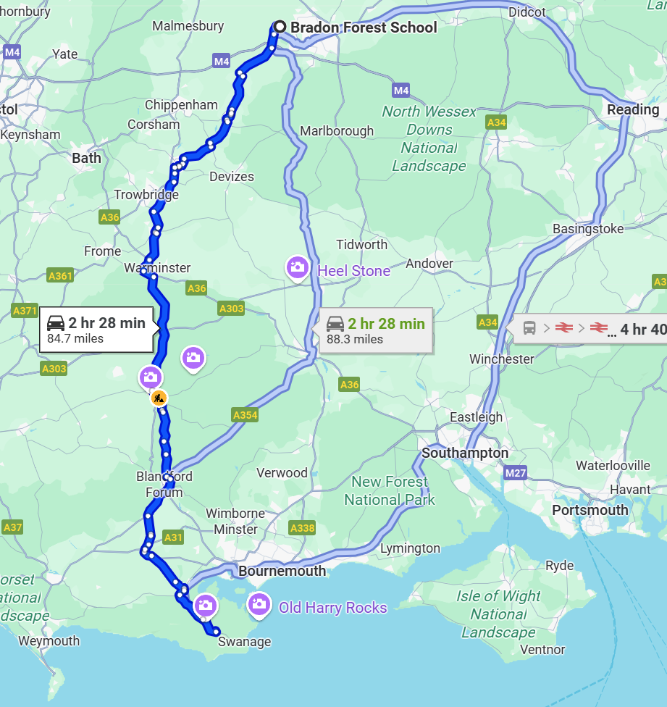
The journey
Students to be in the hall at the latest by 8.30am on Monday 13 July.
We will depart at 9am.
Arrive around midday

Slide 10
Timings – when we are there
Monday 13th July
Arrive at the Campsite - 12:00 - Please bring packed Lunch
1st Activity - 13:00 - 16:00 (Corfe Castle or Water sports depending on group)
Dinner - 17:00
Evening activity: 19:00 - 20:00 (Campfire and rounders)
Tuesday 14th July
Breakfast - 07:30
2nd activity - 09:00 - 12:00 (Corfe Castle or Water sports depending on group)
Lunch - 12:00 - 13:00
Depart from Campsite - 13:00
Return to school around 4pm – Parents will need to collect students.

Slide 11
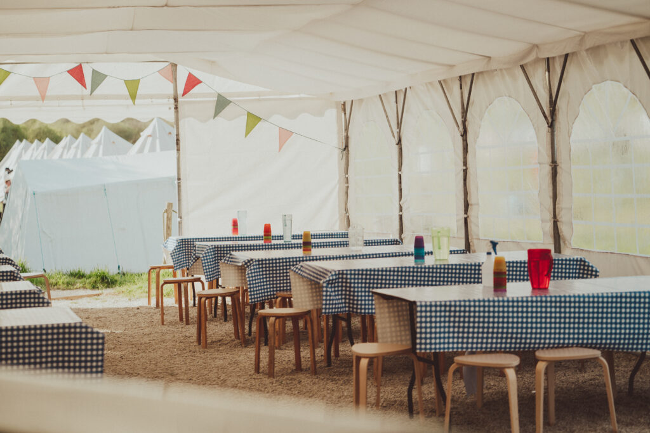
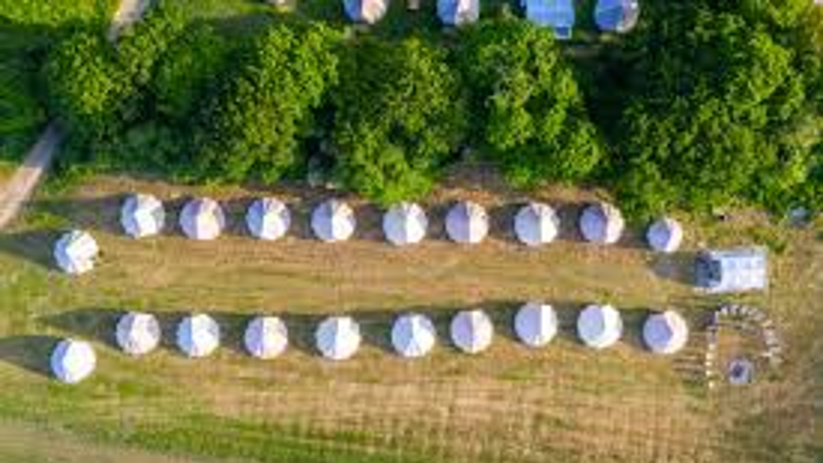
Camp Site
5 metre Bell Tents
Dedicated toilet and shower block
Maximum of 6 students per tent (no less than 3 students)
Single sex tents
Teacher tents alongside student tents
Camping mats are provided- These are thin, if students want more comfort, they can bring an inflatable air bed – this should be light and portable – and students should be able to set this up themselves.
Purbeck Valley Campsite, Valley Rd,
Corfe Castle, BH205HU

Slide 12

Itinerary – Corfe Castle
We will visit Corfe Castle – A National Trust site.
This is one of Britain's most iconic survivors of the English Civil War, partially demolished in 1646 by the Parliamentarians.
Great views across the countryside. Lots to explore!
Spot the 'murder holes' and count the arrow loops. Feel history come to life and see the wildlife that has set up home here – nesting peregrine falcons.

Slide 13
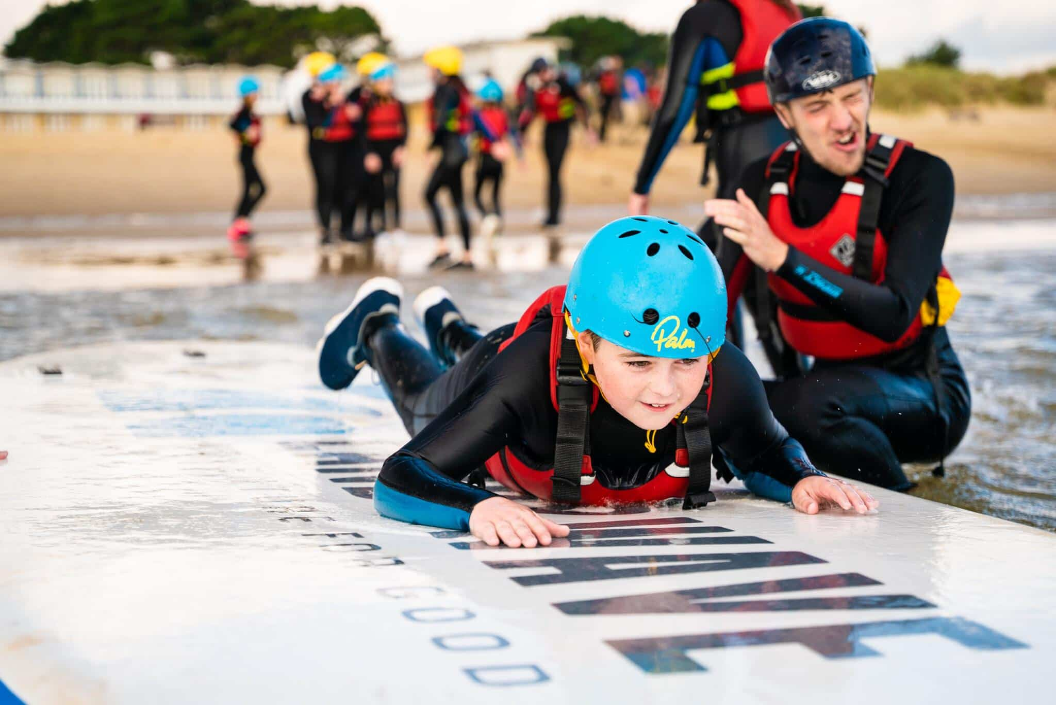
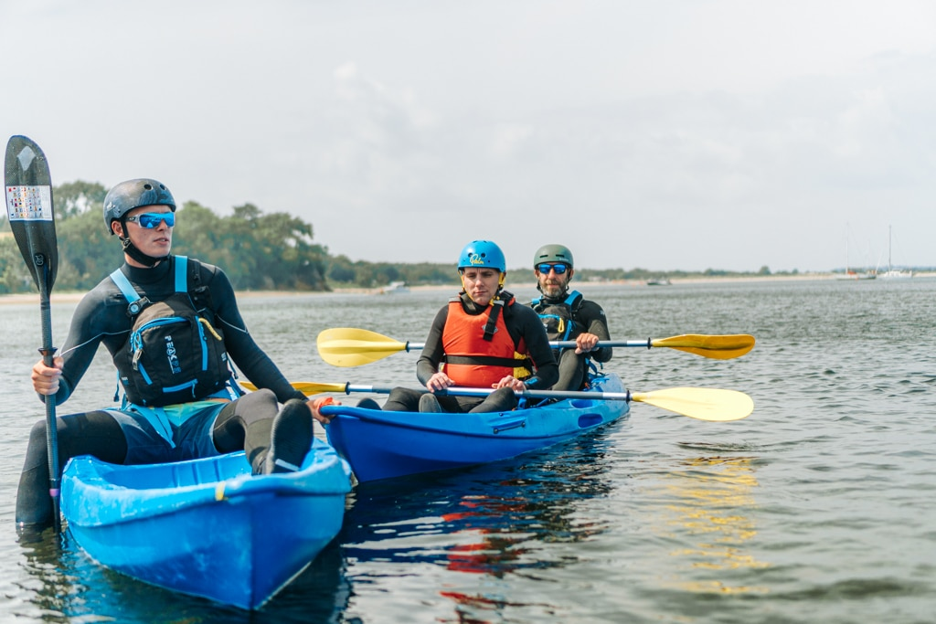
Itinerary
Itinerary – Water sports
The water sports session will hopefully include some kayaking and a jumbo paddle board session.
Full wetsuits and helmets are provided.
Students will need to wear a swimming costume or shorts, and have a towel to dry off with.
Land and Wave have asked that they wear old trainers for this activity. This is a strict rule. Students will not be allowed to wear water shoes or crocs.

Slide 14
Safety and Insurance- Land and Wave
ACTIVITY SAFETY
All Land & Wave instructors . . .
- Have passed an enhanced DBS check
- Hold National Governing Body qualifications
- Are Safeguarding trained
- Will be in/on the water during water activities
All safety equipment and clothing is provided
If the weather is unsafe (high winds or swell),
contingency activities take place to ensure
maximum safety and enjoyment.
I N S U R A N C E
Land & Wave holds £10 million public liability Insurance
They hold an AALS License and the Adventure Mark Certificate
We are accredited by Learning Outside the Classroom (LOTC)

Slide 15
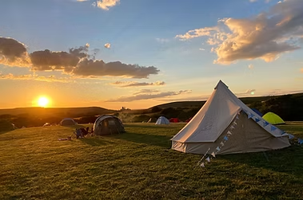
Itinerary – Rounders and Camp fire
We will have our evening meal in camp.
There will be a camp fire and a game of rounders.
I recommend a hoodie or fleece to put on as the evening may be cooler.
Students will be checked in to their tents by the staff. Once they are in, they are expected to stay in until the morning – so they will need to make sure they have cleaned their teeth, been to the loo, etc.

Slide 16
Money
Amount of money to take – up to parents! A small amount only – perhaps a souvenir from Corfe Castle, an ice cream, a snack or drink.
Student will be responsible for their own money and must keep it safe themselves. This may be cash or a card suitable for contactless transactions.

Slide 17
Food
Evening meal is provided.
Breakfast is provided – this will be a range of breakfast items such as cereal and toast.
By now the majority have added details about dietary requirements and packed lunch for day 2 on to the Land and Wave portal –Please keep us updated about any dietary issues if this changes for your child. There are 2 students who still need to do this, according to records on the portal.
All students to bring a packed lunch on day 1
If you know that your child may not eat the food provided, please make Miss Cole aware of this before the trip.
Students can bring their own snacks. No nut products, please.
We have a range of allergies amongst the group – please do not bring nuts of any kind.

Slide 18
Weather
Weather forecast – please check before we go.
Be prepared for British Summer – could be anything!

Slide 19
What to pack – please see the full kit list provided!
– a few points to note.
Sleeping bag and pillow – plastic bin bag to keep them dry/clean. Airbed if wanted – there are sleeping mats provided. (they need to be able to inflate this themselves.)
Comfortable clothing – suitable for being in the outdoors.
Nightwear (not skimpy! Suitable for being seen in – think going to the toilet in camp)
Footwear – two sensible pairs – you will be walking to Corfe Castle. They will need old trainers to do the water sports – so one pair that will get wet.
Medicines/equipment – first aid kit carried by staff
Waterproof Coat
Hat – sun – and sunscreen factor 30+
Bag suitable for carrying to the coach/tent.
Torch
Toiletries and two towels – one for the water sports, one for in camp. No aerosol sprays please, – we have students with asthma.
No nuts/nut ingredients in toiletries/sunscreen, please.
Some snacks – not too many sweets please – PACKED LUNCH needed. Please put this in a Tupperware style box. No nuts.
No devices
Plastic bin bags for wet and dirty clothing
Don’t pack valuable items that are irreplaceable.
Swimming costume/shorts/trunks – for under your wetsuit.
Please name all items!
You would not believe how many things are left lying around! We will want to find their owners, and I expect you will want them back!

Slide 20
Mobile Phone and internet use/social media
We are not expecting students to have phones or devices.
If found with a phone or device, we will confiscate the phone. It will be returned to parents when we arrive home.
Please reassure your child that if there are any issues they can speak to their group teacher, or another member of staff on the trip – and they will help them. If they are worried we can always use the school phone to call parents for a quick chat.
We want to encourage students to be with their friends and enjoy themselves, without the pressure that phones can bring.
It is not for long!
Any streaks can be sorted Monday morning and Tuesday night!

Slide 21
Behaviour and safety
School sanctions can be imposed on our return
We will limit your own free time while we are away if necessary
Poor behaviour on the trip may affect your attendance on othe trips in the future
TRUST is key to a successful and enjoyable trip for everyone.
Noone wants to ruin your holiday, but you can’t ruin everyone else’s either.
Parents and students have a behaviour contract – this needs to be signed and returned to Miss Cole
Behave with consideration for the safety of yourself and others.
Look after each other
Be kind
No running, shouting and annoying members of the public. No loud swearing.
If you break things, you have to pay for them.
Staff are working 24 hours a day and giving up their own time ….think before you act. They are NOT on holiday.
Listen to instructions.
Do not go anywhere on your own.
When you are checked in to your tent at night, stay put until designated time in the morning.
If you need to the toilet – you must go in pairs and return to your tent straight away.
Do not make unnecessary mess – anywhere.
Make sure you eat and drink – you will feel rubbish if you don’t

Slide 22

Run, Hide, tell
You are visiting sites where it unlikely, however, we have to tell you this - potential for a terrorism style incident.
UK Government advice is the following :
Run – get away from the situation – as far as possible.
Hide – hide away from potential danger – keep quiet, turn phone on silent/no vibrations. Stay there.
Tell – if safe to do so.
Please follow advice of official emergency services – police, ambulance, fire.

Slide 23
And finally...
REMINDER!
Please return the following documents to the box on the front if you are able to do so this evening: Please place these in the envelope provided and write your child's name on it.
Medical Administration Form – Yellow (please hand this in even if your child will not need any medication)
Behaviour Contract – Blue
If you are unable to return these this evening, please make sure they are returned to Miss Cole at school by 25th June. It is great if your child can be encouraged to hand it in – it is great to see them and check in before the trip.

